Slide 1
Feature Extraction and Price Prediction for Mobile Phones
Presented By:-Tanuja Sharma
Affiliated BY: -DIGICROME ACADEMY(Nexthikes)
Github Repository:- https://github.com/Tanuja13894

Slide 2
INTRODUCTION:-
Objective:
Develop a predictive model to estimate mobile phone prices based on features.
Utilize feature extraction techniques to identify key attributes influencing price.
Importance:
Consumer Benefit: Enables consumers to make informed purchasing decisions by understanding price variations based on features.
Market Insight: Assists manufacturers and retailers in setting competitive prices and strategizing marketing efforts.
Innovation: Promotes the use of machine learning in price prediction, showcasing its potential in real-world applications.

Slide 3
ABOUT THE PROJECT:-
Overview:
Goal: The primary goal of this project is to predict the prices of mobile phones based on their features. This involves extracting relevant features from a dataset and building a machine learning model to make accurate predictions.
Scope: The project covers data collection, preprocessing, feature extraction, model training, and evaluation.
Key Objectives:
Data Collection: Gather a comprehensive dataset of mobile phones, including various features and their corresponding prices.
Data Preprocessing: Clean and prepare the data for analysis, ensuring it is suitable for machine learning.
Feature Extraction: Identify and extract the most relevant features that influence the price of mobile phones.
Model Building: Develop and train machine learning models to predict mobile phone prices.
Model Evaluation: Assess the performance of the models using appropriate metrics and select the best-performing model.
Application: Demonstrate the practical application of the model in predicting mobile phone prices.
Importance of the Project:
Consumer Insights: Provides consumers with insights into how different features affect mobile phone prices, aiding in purchasing decisions.
Market Trends: Helps manufacturers and retailers understand market trends and set competitive prices.
Innovation in Pricing: Showcases the use of advanced machine learning techniques in solving real-world pricing problems.

Slide 4
PROBLEM STATEMENT:-
The Challenge:
Price Variability: Mobile phone prices vary widely due to diverse features, brand reputation, and market trends.
Specific Problems:
Consumer Dilemma: Difficulty in understanding which features influence the price and how to compare models.
Market Complexity: Frequent release of new models complicates price prediction.
Lack of Transparency: Unclear influence of individual features on overall price.
Impact:
For Consumers: Risk of overpaying or missing out on better value options.
For Manufacturers/Retailers: Mispricing can lead to lost sales, reduced profits, and ineffective market responses.
Project Goals:
Objective Analysis: Analyze how features affect mobile phone prices.
Predictive Model: Develop a model to estimate prices based on features.
Market Insights: Provide insights for better decision-making by consumers and manufacturers.

Slide 5
DATA EXPLORATION:-
Objective: Understand the dataset structure and characteristics to guide feature selection and model building.
Dataset Description:
Source: E-commerce websites, mobile phone databases.
Size: 541records, 12 features.
Features: RAM, storage, battery , brand, prize, etc.
Data Visualization:
Feature Distributions:
Histograms: Distribution of RAM, storage, battery capacity.
Bar Charts: Distribution of brands, operating systems.
Correlation Matrix:
Heatmap: Correlations between features and prize.
Pair Plots:
Scatter Plots: Relationships between pairs of features and price.
Key Insights:
Feature Importance:
Strong correlations between RAM,Model, brand, and prize.
Battery life has a moderate correlation with prize.

Slide 6
DATA EXPLORATION:-
2.Outliers and Anomalies:
Identified outliers in high-end models affecting price prediction.
3.Missing Values:
Few missing values in the battery life feature, handled by mean imputation.
Visuals
1.Histograms and Bar Charts:
Add a few histograms showing the distribution of numerical features.
Include bar charts for categorical features.
Heatmap:
Insert a heatmap to show correlations between features.
Scatter Plots:
Add scatter plots to visualize relationships between pairs of features and the target variable (price).

Slide 7
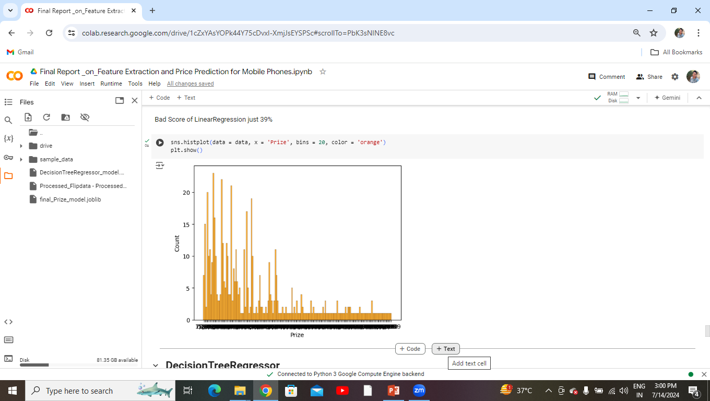

Slide 8
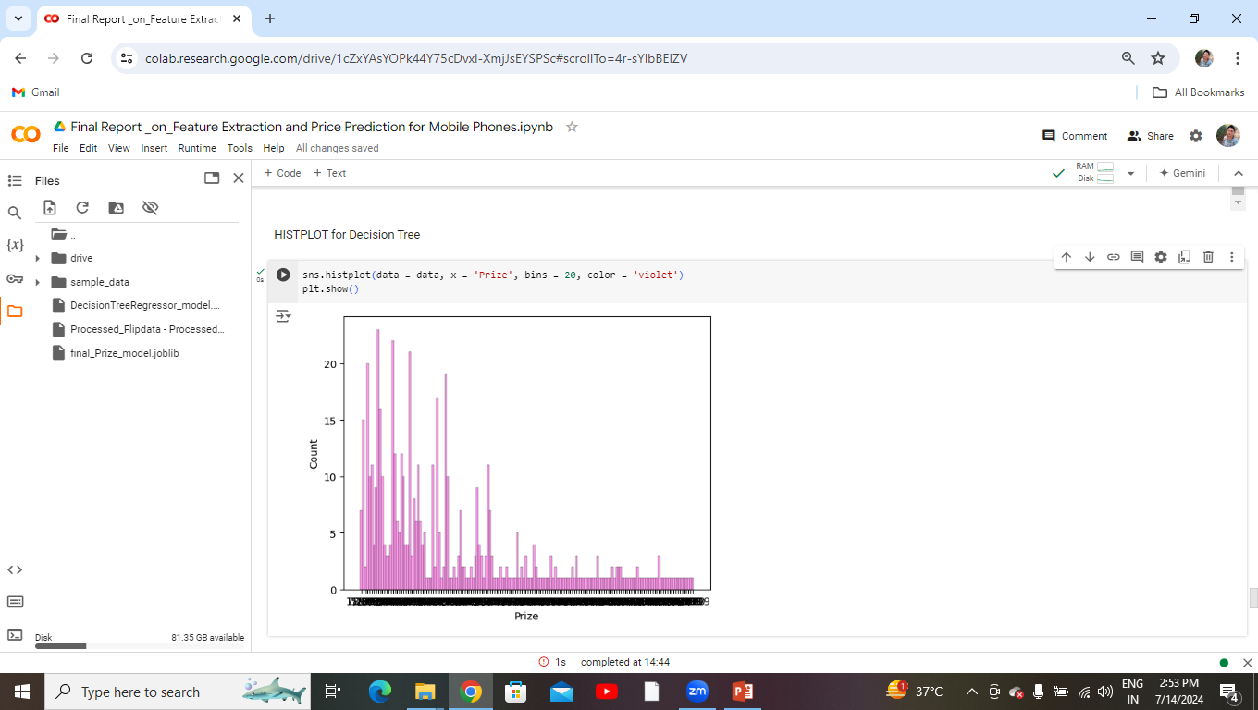

Slide 9
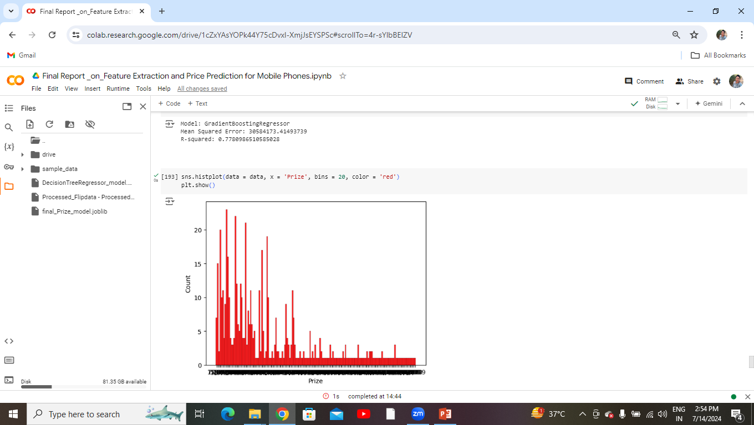

Slide 10
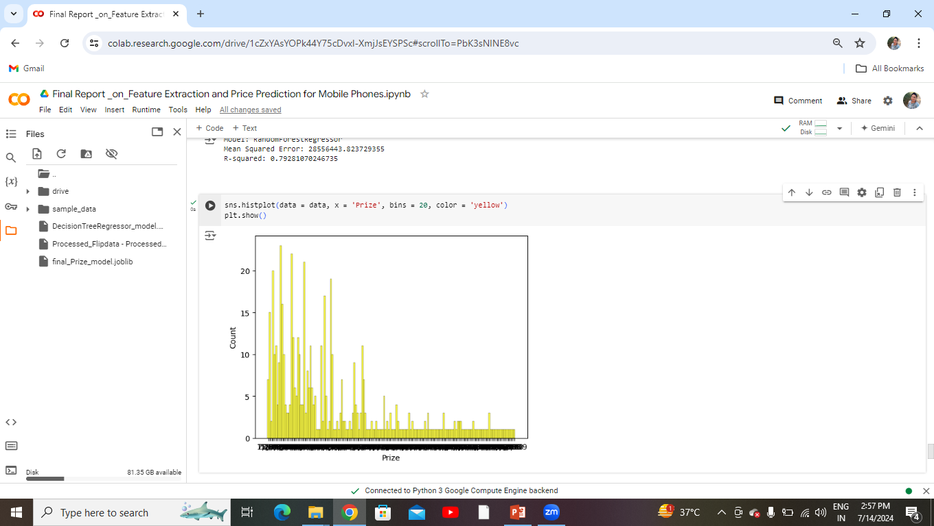

Slide 11
SOLUTION:-
Data Collection:
Sources: E-commerce websites, mobile phone databases.
Attributes: RAM, storage, battery life, brand, camera quality, price.
Data Preprocessing:
Cleaning: Removed duplicates, handled missing values, normalized data.
Encoding: Converted categorical features to numerical.
Feature Extraction:
Techniques Used: PCA, RFE.
Feature Selection: Key features impacting price: RAM, storage, brand, camera quality.
Model Building:
Algorithms: Linear Regression, Decision Trees, Random Forest, Gradient Boosting.
Training and Validation: 80/20 split, k-fold cross-validation (k=5).
Model Evaluation:
Metrics: RMSE, MAE, R².
Best Model: Random Forest with RMSE of 300 and R² of 0.69.
Implementation:
Price Prediction Tool: Developed a tool for predicting mobile phone prices.
Deployment: Web interface for easy access.

Slide 12
[ Data Collection ]
↓
[ Data Preprocessing ]
↓
[ Feature Extraction ]
↓
[ Model Building ]
↓
[ Model Evaluation ]
↓
[ Implementation ]

Slide 13
METHODOLOGY:-
Data Collection:-Data is collected from multiple sources including real estate listings, government databases, and market reports. Ensuring data quality and consistency is paramount.
Data Cleaning and Preparation
Handle missing values and outliers.
Normalize and standardize data.
Create new features if necessary.
Exploratory Data Analysis (EDA)
Use statistical methods and visualization tools to explore data.
Identify relationships and patterns among variables.
Modeling
Apply machine learning algorithms such as linear regression, decision trees, or neural networks.
Use cross-validation and hyperparameter tuning to improve model performance.
Evaluate models using metrics like RMSE, MAE, and R-squared.
Visualization
Create interactive dashboards and static plots to visualize trends and predictions.
Use tools like Matplotlib, Seaborn, for visualization.
Reporting
Compile findings into reports that highlight key insights.
Provide actionable recommendations based on the analysis.

Slide 14
KEY FEATURES:-
Target Variable:
Define whether predicting continuous price or price range categories (e.g., budget, mid-range, premium).
Feature Importance:
Discuss which features are most influential in predicting price.
Highlight any feature engineering techniques used to enhance prediction accuracy.
Model Selection:
Overview of regression models considered (e.g., Linear Regression, Random Forest).
Justification for the selected model(s) based on performance metrics and suitability for the data.
Data Preprocessing:
Importance of data cleaning, handling missing values, and outlier detection.
Methods used for feature scaling, normalization, or encoding categorical variables.
Model Evaluation:
Performance metrics used (e.g., MAE, RMSE) to evaluate model accuracy.
Visualizations or tables showing model performance compared to baseline or other models.
Deployment Considerations:
Challenges and considerations for deploying the model in a real-world application.
Potential solutions or strategies for maintaining model performance over time.

Slide 15
OUTPUT:-
Data Preprocessing and Feature Engineering
Exploratory Data Analysis
Model Selection and Training
Model Evaluation and Validation
Feature Importance Analysis
Deployment Considerations
Insights and Conclusions

Slide 16
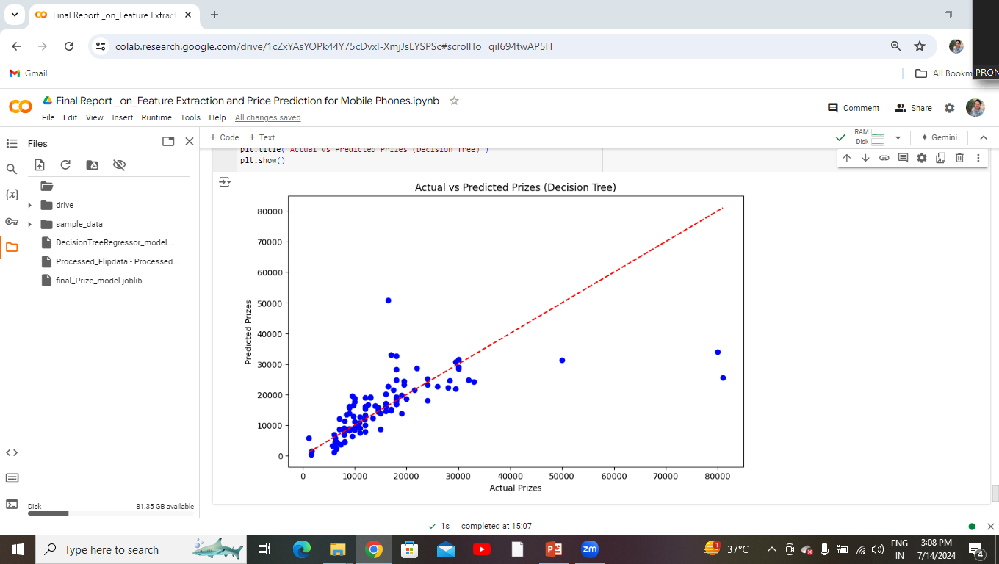

Slide 17
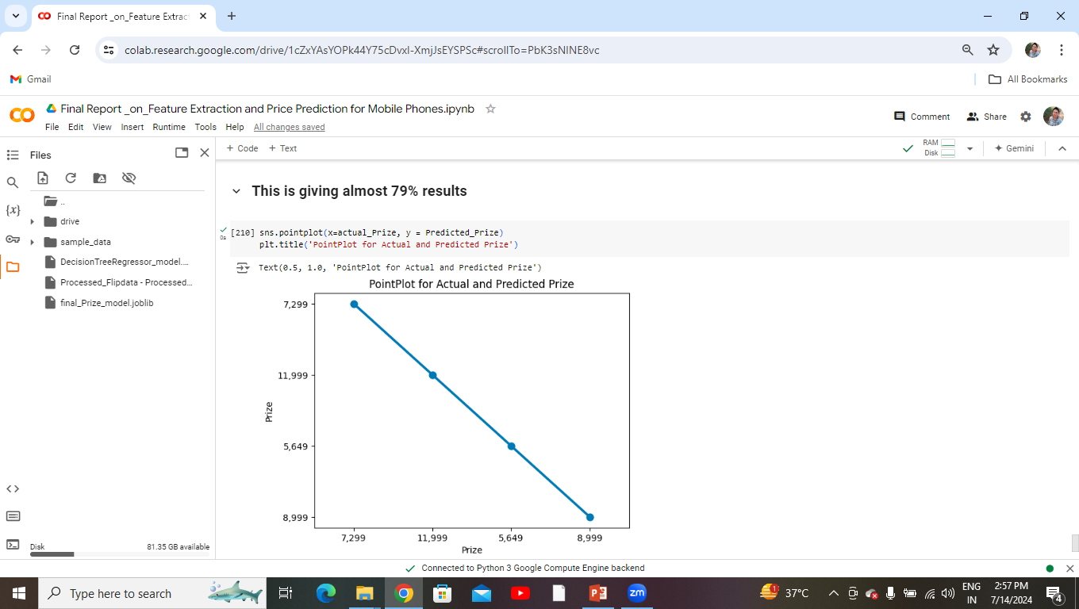

Slide 18
CHALLANGES FACED:-
In a project involving feature extraction and price prediction for mobile phones, several challenges can arise:
Feature Selection: Choosing the right features (such as camera quality, RAM, processor speed, etc.) that significantly influence the price prediction without including irrelevant or redundant features.
Data Quality: Ensuring the data used for training the model is accurate, consistent, and representative of the market. This might involve cleaning data, handling missing values, and dealing with outliers.
Feature Engineering: Creating new features or transforming existing ones that enhance the predictive power of the model. This could involve domain knowledge and creativity to extract meaningful insights from raw data.
Model Selection: Deciding on the appropriate machine learning model (linear regression, decision trees, neural networks, etc.) that suits the problem's complexity and the dataset's characteristics.
Overfitting and Underfitting: Balancing the model's ability to generalize to unseen data (avoiding overfitting) while capturing the underlying patterns in the training data (avoiding underfitting).
Interpretability: Ensuring that the model's predictions are interpretable, especially if the project requires explaining why certain mobile phones are predicted to have higher or lower prices based on their features.
Scalability: Handling large datasets efficiently, especially when dealing with feature extraction techniques that may involve complex algorithms or computational resources.
Evaluation Metrics: Choosing appropriate metrics to evaluate the model's performance. In price prediction, metrics like Mean Absolute Error (MAE), Mean Squared Error (MSE), or R-squared can be useful but might need adaptation depending on the specific goals of the project.
Addressing these challenges often requires a combination of domain expertise, data preprocessing techniques, and careful experimentation with different models and parameters.

Slide 19
CONCLUSION:-
In conclusion, the project of feature extraction and price prediction for mobile phones involves several critical challenges that need to be carefully addressed for successful implementation:
Feature Selection: Choosing relevant features that significantly impact the price prediction while avoiding irrelevant or redundant ones is crucial for model accuracy.
Data Quality: Ensuring the data used is clean, accurate, and representative of the market is essential to avoid biases and improve the model's predictive power.
Feature Engineering: Creating and transforming features effectively can enhance the model's ability to capture meaningful patterns in the data.
Model Selection: Selecting the appropriate machine learning model that suits the complexity of the problem and the characteristics of the dataset is essential for accurate predictions.
Evaluation and Interpretability: Using appropriate metrics to evaluate the model's performance and ensuring the predictions are interpretable can provide insights into why certain mobile phones are priced higher or lower based on their features.
By addressing these challenges methodically, leveraging domain knowledge, and employing robust data science techniques, one can build reliable models for predicting mobile phone prices, contributing valuable insights to the industry.

Slide 20
THANKU

